Slide 1


Beyond the patient: Studying whole healthcare systems using claims data
San Francisco, CA
10/17/2012
Notes:
Booz Allen Hamilton Standard Colors
Colors should be used in the color pairs whenever possible. Do not mix and match colors, use pairs together as shown.
Black, White and Gray can be used with any of the other colors.
Purple
Pantone 2765
R 12
G 4
B 79
Green
Pantone
357
R 15
G 67
B 24
Blue
Pantone 2
88
R 11
G 31
B 101
Black
Pantone Cool Gray 6
R 158
G 158
B 158
Red
Pantone
485
R 252
G 5
B 14
Yellow
Pantone 3965
R 232
G 244
B 4
Aqua
Pantone
319
R 126
G 204
B 189
White

Slide 2







The important questions in healthcare are no longer about individual patients; they are about systems of care.
Geographic Systems
Time Systems
People Systems
Episodes of Care
Access to Care
Coordination of Care

Slide 3
Decision-makers will turn to complex analysis when we prove it’s better, faster, and cheaper.
Systems Analysis
New data collection
How can we measure ambulatory care quality effectively and fairly?
Do we need another dermatologist in Tulsa?
Intuition
Systems Analysis
Is offering chiropractic coverage worth it?
Geographic Systems

Slide 4
How should patients and providers be organized?

Slide 5
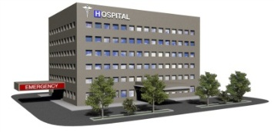


We know very little about how we should build organizations to coordinate care.
Reduced cost
Better patient relationships
Consistency of care
Transparency for patients
Reduced redundancy
Higher quality
Emphasis on primary care workforce
Close coordination between providers
Limited panel of providers
“Weakest link” total quality
Consolidation-related price increases
Market power
Cronyism
Groupthink

Slide 6



Existing direct comparisons produce robust results.
Social network analysis provides access to more definitions of coordination.
VS.
But are not dynamic.
And more degrees of coordination.

Slide 7
Social network analysis provides the vocabulary for talking about people systems.
Density: Extent to which every provider is connected to every other provider
Clustering: Extent to which providers form natural groups
Degree: The number of providers any individual provider connects with

Slide 8
To study the provider and patient social networks, we can derive a network from claims data.
Providers are linked to patients by claims.
Each patient can see many providers.

Slide 9
The most important links are the ones between doctors who share many patients.

Slide 10
Each patient’s network is unique.
Weak Links =
Low Density
Strong Links =
High Density

Slide 11

Results: High density may reduce total claims, not average cost.
Provider
Density
Average cost of
services
Total claims

Slide 12
Social network analysis helps us balance costs and benefits of coordination.
Information
Noise
Collaboration
Collusion
Consolidation
Diversity

Slide 13
Social network analysis is better than field experiments.
Better
All the possible organizational structures
Faster
Months instead of years
Cheaper
Uses networks derived from claims data

Slide 14
How Is Healthcare Changing?

Slide 15
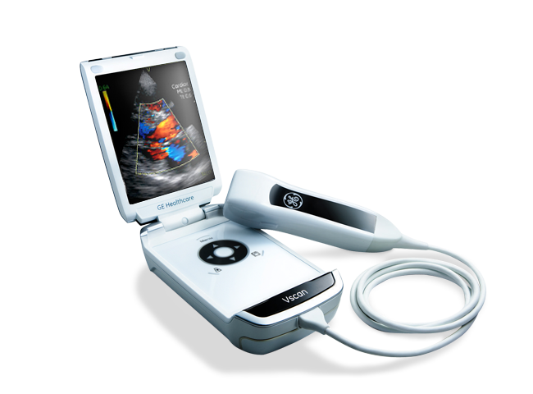
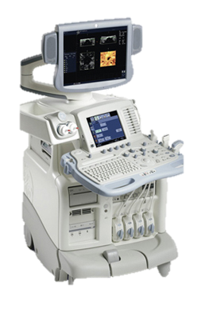

Now, payers rely on experts to tell them when innovation happens.
Handheld echocardiograph
Works more like this
Than this.
Simple analysis of provider billing patterns can detect healthcare changes.

Slide 16

Temporal analysis looks for beginnings and endings.
Case mix shift
Healthcare episode
Outbreak

Slide 17


Even though claims data don’t contain real cost, they can tell us what procedures are becoming more cost-effective.
Hunting for transitions within providers helps isolate changes in healthcare from trends in demand.
Procedure cost goes down
Procedure X
Procedure incidence goes up
Procedure Y

Slide 18
The innovation detector spotted major healthcare innovations in 2009 data.
Stereoscopic X-ray Guidance
Made cheaper by ability to retrofit existing devices with the capability.
Data say 43 providers switched in 2009.
Digital Mammography
Made more cost-effective by an increase in reimbursement.
Data say 46 providers switched in 2009.
Transthoracic echocardiogram with color and doppler
Made more possible by real-time 3D echo systems
Data say 48 providers switched in 2009.

Slide 19
Event detection is better than MOST expert judgment.
Better
No profit motives or specialized expertise
Faster
Days instead of months
Cheaper
A handful of analysts

Slide 20
Where should providers be?

Slide 21


Existing research on access focuses on matching one thing.
Location-based simulation methods permit measurement of true access.
Ethnic Concordance
Physical Access

Slide 22
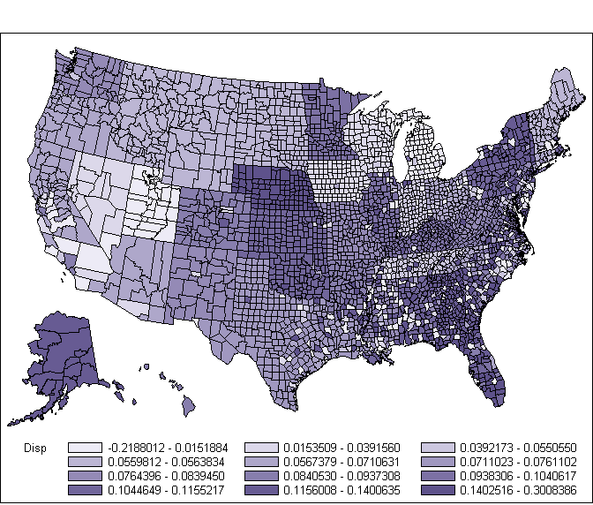
Ethnic disparities in preventive care persist despite equal healthcare coverage.
Differences in lipids panel rates between White and African American Medicare beneficiaries
Lipids
darker color=
greater disparity

Slide 23

We measured true access by measuring how many doctors local, similar people go to
And patient-provider match.
Access is location
Providers
Access for each African-American is the number of doctors that her neighbors used.
Patients

Slide 24




We measured individual healthcare disparity using simulation.
Where care is low for everyone, ethnic disparities are low.
Where care is low just for African-Americans, disparities are high.
Comparing each person to a random match
And repeating
Creates a personalized measure of healthcare disadvantage.

Slide 25
Results: Access to facilities may have a bigger impact on preventive care disparities than access to office-based providers.
Access to Office-Based Providers
Access to Facilities
Preventive Care
Disparity

Slide 26
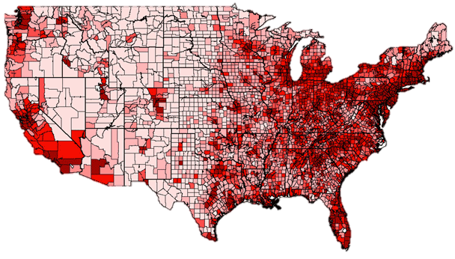
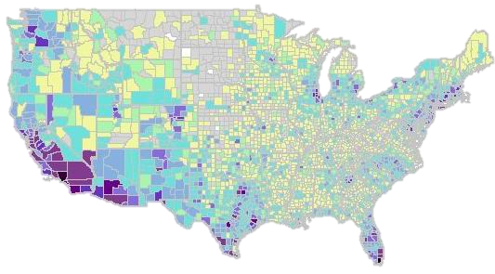
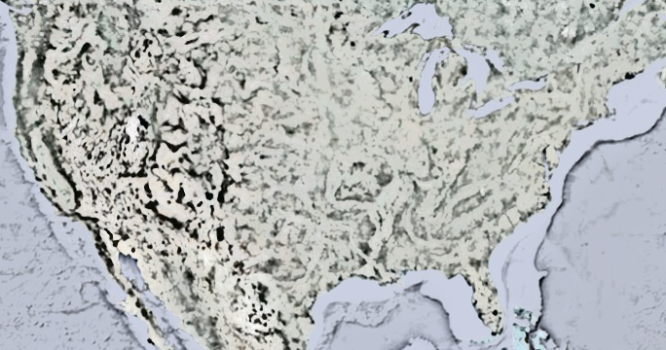
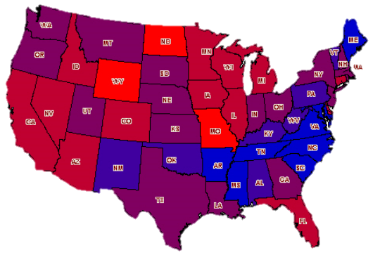

We can use space to operationalize complex concepts like culture.
Instead of getting data from several sources and trying to combine them…
We can control for variation by analyzing each person with respect to the neighborhood.
Population density
Language
Income

Slide 27
Geospatial methods are much better than other data analysis techniques for questions about location.
Better
No variance estimation issues
Faster
Days instead of months
Cheaper
A single data source

Slide 28
Designing Evidence-Based Healthcare Systems

Slide 29
Evidence-based healthcare means evidence-based systems.
Field experiments and expert intuition are not fast or agile enough.
Innovations in computing and analysis give us the tools to analyze systems better, faster, and cheaper using the data we already have.
As champions of analytics, we should be promoting the simple uses of these data for making everyday business decisions better.

Slide 30
Thank you
Riki Conrey, PhD
Conrey_Riki@bah.com
www.boozallen.com/analytics

